Slide 1

Document ID
Version: 1.0
Standard Operating Procedure for Data Governance Plan
Date of creation: 2024 April 02
Farzana
PARTICULARS
Scope
Responsibilities
Procedure
Flowchart

Slide 2
Purpose
This SOP outlines the process for developing a comprehensive data governance plan for an organization. The plan will establish frameworks, policies, and procedures to ensure the quality, security, accessibility, and integrity of data assets throughout their lifecycle.
Scope
This SOP applies to the creation of a data governance plan for all data owned or managed by the organization, regardless of source or format.

Slide 3
Responsibilities
Data Stewards
Appointed individuals responsible for specific data domains or assets. Oversee data quality, security, and compliance within their assigned area.
Data Governance Officer
Leads the development and implementation of the data governance plan.
IT Departments
Provides technical expertise and infrastructure support for data governance initiatives.
.
Business Users
Utilize data for analysis and decision-making. Responsible for adhering to data governance policies.

Slide 4

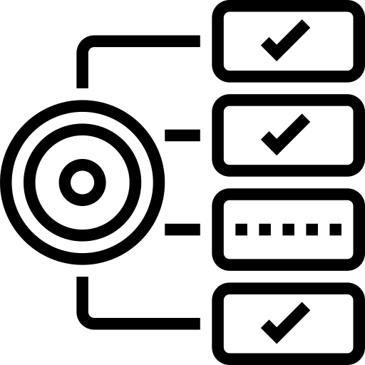
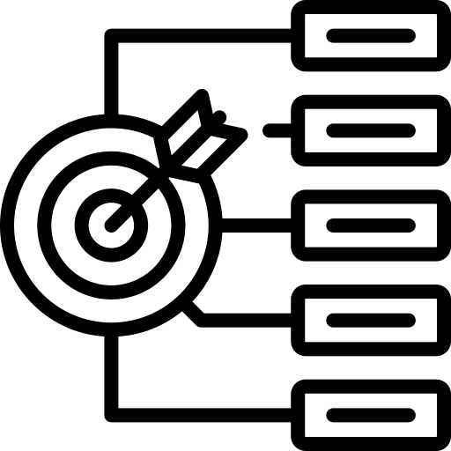
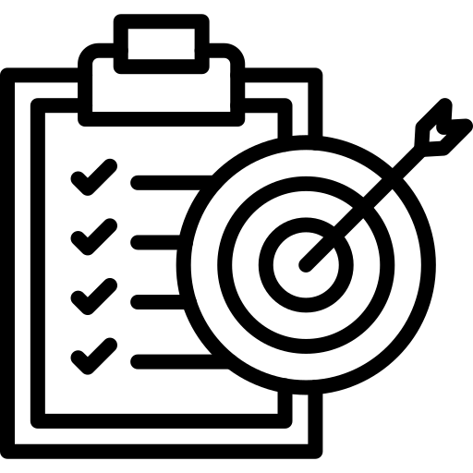
Requirements
Data inventory tools
Data classification framework template
Data quality management tools
Data security policy documentation

Slide 5
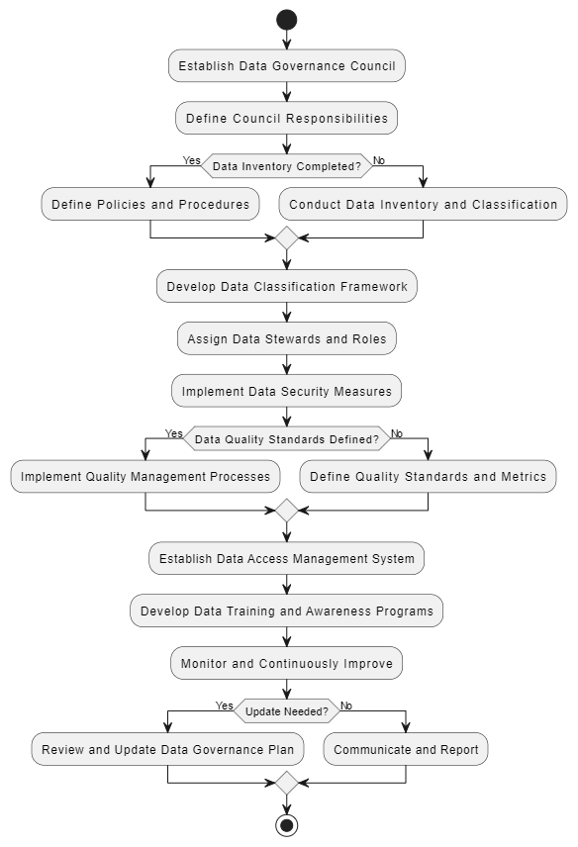
Flowchart of Data Governance Plan

Slide 6
Procedure for Data Governance Implementation
1. Establish Data Governance Council:
Form a data governance council with representatives from key business units, IT, and legal departments.
Define the council's responsibilities, including setting data governance goals and overseeing plan implementation.
2. Data Inventory and Classification:
Conduct a comprehensive data inventory to identify all data assets owned or managed by the organization.
Develop a data classification framework to categorize data based on sensitivity, criticality, and regulatory requirements.
3. Define Data Governance Policies and Procedures:
Develop data governance policies addressing areas like data ownership, access control, data quality management, data retention, and data security.
Establish procedures for data usage, data breach notification, and data lifecycle management.

Slide 7
4. Assign Data Stewards and Roles:
Identify and appoint data stewards for specific data domains or assets.
Clearly define the roles and responsibilities of data stewards, including data quality monitoring, access control enforcement, and user training.
5. Implement Data Security Measures:
Implement data security measures aligned with the data classification framework, including access controls, encryption, and intrusion detection systems.
Ensure compliance with relevant data privacy regulations (e.g., GDPR, CCPA).
6. Data Quality Management:
Define data quality standards and metrics for different data sets.
Implement data quality management processes to identify and remediate data inconsistencies and errors.

Slide 8
7. Data Access Management:
Establish a data access control system that grants access to data based on the principle of least privilege.
Define user access request procedures and approval workflows.
8. Data Training and Awareness:
Develop data governance training programs for business users and data stewards.
Raise awareness about the importance of data governance and best practices for data handling.
9.Monitoring and Continuous Improvement:
Regularly monitor the effectiveness of the data governance plan and identify areas for improvement.
Review and update the data governance plan periodically to reflect changes in business needs and regulations.
10. Communication and Reporting:
Establish clear communication channels regarding data governance policies and procedures.
Develop reporting mechanisms to track data governance activities and performance metrics.
8

Slide 9
General Instructions
Thorough Understanding: Ensure a comprehensive understanding of the organization's data landscape, including data sources, formats, usage, and regulatory requirements.
Collaborative Approach: Collaborate closely with stakeholders from various departments, including IT, legal, and business units, to gather insights and ensure alignment with organizational goals.
Customization: Tailor the data governance plan to suit the organization's specific needs, industry regulations, and data maturity level.
Documentation: Maintain detailed documentation of all data governance policies, procedures, and decisions for transparency and accountability.
Training and Awareness: Provide regular training sessions and awareness programs to educate staff about data governance principles, policies, and procedures.
Continuous Improvement: Continuously monitor and evaluate the effectiveness of the data governance plan, making adjustments as needed to address evolving business requirements and data challenges.

Slide 10
General Challenges
Resistance to Change: Overcoming resistance from stakeholders who may be accustomed to existing data management practices or reluctant to adopt new policies and procedures.
Data Silos: Addressing data silos and disparate systems within the organization that may hinder data governance efforts and data quality.
Resource Constraints: Managing data governance initiatives with limited resources, including budget, time, and skilled personnel.
Data Quality Issues: Dealing with data quality issues such as inconsistencies, inaccuracies, and incomplete data sets that may undermine the integrity and reliability of decision-making.
Regulatory Compliance: Ensuring compliance with evolving data privacy regulations and standards, which may require ongoing adjustments to data governance practices.

Slide 11
Process Implementation Checklist
Do’s | Don’ts
Do Communicate Effectively | Don't Neglect Training
Do Prioritize Data Security | Don't Ignore Feedback
Do Foster Collaboration | Don't Overcomplicate
Do Monitor Performance | Don't Assume Compliance
Do Stay Updated | Don't Forget Governance Structure

Slide 12
Inputs

Slide 13
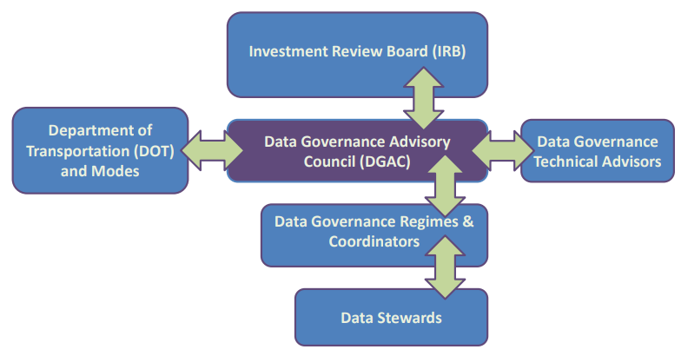
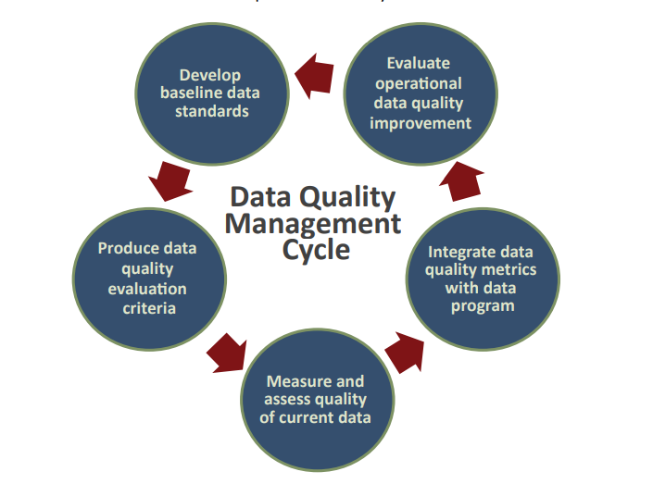
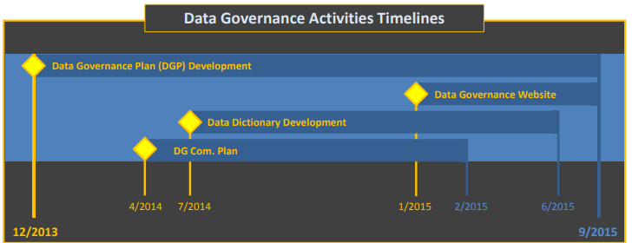
Link to Sample

Slide 14
Revision History
Appendix
Archives
https://www.fhwa.dot.gov/datagov/dgpvolume%201.pdf

Slide 15
THANKYOU

